Slide 1
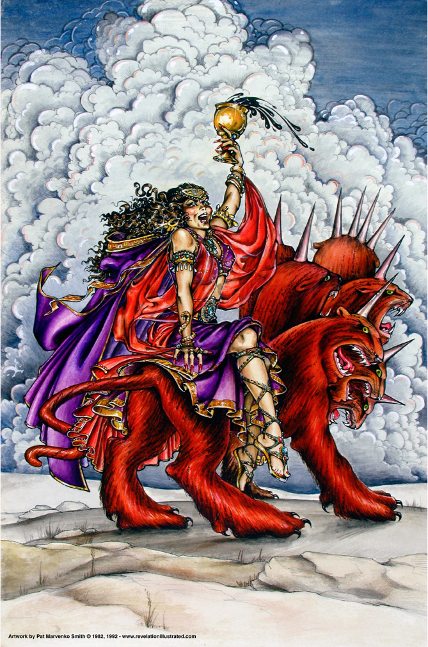
Book of Revelation:
Chapter 18
Fallen is Babylon the Great

Slide 2
Revelation
I. Struggle on Earth (1-11)
A. John’s Vision (1)
B. Letters to 7 churches (2-3)
C. God in control (4-5)
D. Opening of seven seals (6-11)

Slide 3
Revelation
II. Christ And The Dragon In Conflict (12-22)
(Deeper Spiritual Meaning)
A. War (12-14)
B. Bowls of Wrath (15-16)
C. Fall of Babylon the Harlot (17-18)
D. Victory of God’s people (19-21)
E. Warnings about the Book (22)

Slide 4
Revelation 18
“The Fall of Babylon the Harlot”
Outline
The Announcement from Heaven of Her Fall (verses 1-8)
Those Who Mourn Her Fall (verses 9-19)
Her Fall Causes Rejoicing (verse 20)
The Finality of Her Fall (verses 21-24)

Slide 5
Revelation 18
“The Fall of Babylon the Harlot”
Outline
The Announcement from Heaven of Her Fall (verses 1-8)
  Angel with great authority said: (verses 1-3)
    Babylon is fallen, is fallen (verse 2)
    Babylon has become: (verse 2)
    The reason for her fall (verse 3)
  Another voice from heaven said: (verses 4-8)
    “Come out” to God’s people who dwell in her (verse 4)
    She will receive her just reward (verses 5-8)

Slide 6
Revelation 18
“The Fall of Babylon the Harlot”
Outline
II. Those Who Mourn Her Fall (verses 9-19)
  Kings of the earth (verses 9-10)
  Merchants (verses 11-17a)
  Shipmasters (verses 17b-19)

Slide 7
Revelation 18
“The Fall of Babylon the Harlot”
Outline
III. Her Fall Causes Rejoicing (verse 20)
  In heaven
  Among those avenged by her fall

Slide 8
Revelation 18
“The Fall of Babylon the Harlot”
Outline
IV. The Finality of Her Fall (verses 21-24)
  Illustrated by the angel throwing a stone into the sea (verse 21)
  All activity will cease in her (verses 22-23)
  Reason: She had slain prophets and saints (verse 24)

Slide 9
Revelation 18
Sin and a Nation
“Righteousness exalts a nation,
But sin is a reproach to any people”
(Proverbs 14:34)
“This is the fate of a city that built a civilization
without God”
– William Barclay, Revelation, 2:216
“Nothing can be economically good
that is morally bad”
– Ray Summers, Worthy is the Lamb, page 194

Slide 10
What became of Babylon?
… And when?

